Slide 1
STOCK PRICE PREDICTION
RNS INSTITUTE OF TECHNOLOGY
BENGALURU - 98
DEPARTMENT OF COMPUTER SCIENCE & ENGINEERING
Presentation on Internship
VII Semester, Department of CSE, RNSIT
2021 - 2022

Slide 2
CONTENT
Abstract
About the Company
Machine Learning
Deep Learning
Deep Learning Necessity
Apple Stock Price Dataset
Requirements
Algorithm
Implementation
Results
Conclusion
References
VII Semester, Department of CSE, RNSIT
2021 - 2022

Slide 3
ABSTRACT
Demand of Stock have become huge with Increased in popularity of Stock in Digital world. Prediction and Analysing stock can benefit People to think before buying or selling stocks. So, A New Stock Price Prediction through Deep Learning Algorithms has been analysed and visualized and predict the future stock price. Through This System we can predict of any Company stock in the world.
VII Semester, Department of CSE, RNSIT
2021 - 2022

Slide 4
ABOUT THE COMPANY
NASTECH – New Age Solutions & Technologies
NASTECH is formed with the purpose of bridging the gap between Academia and Industry.
Nastech is one of the leading Global Certification and Training service providers for technical and management programs for educational institutions.
They collaborate with educational institutes to understand their requirements and form a strategy in consultation with all stakeholders to fulfill those by skilling , reskilling and upskilling the students and faculties on new age skills and technologies.
Industry and project oriented student training programs.
Certification programs mapped to Global Certification Exams from Microsoft/EC- Council/Google/AWS/ Adobe).
VII Semester, Department of CSE, RNSIT
2021 - 2022

Slide 5
MACHINE LEARNING
Machine learning is the science of getting computers to act without being explicitly programmed.
Machine learning is a method of data analysis that automates analytical model building
Machine learning is important because it gives enterprises a view of trends in customer behaviour and business operational patterns, as well as supports the development of new products
VII Semester, Department of CSE, RNSIT
2021 - 2022

Slide 6
DEEP LEARNING
Deep learning is an artificial intelligence (AI) function that imitates the workings of the human brain in processing data and creating patterns for use in decision making.
Deep learning is a subset of machine learning in artificial intelligence that has networks capable of learning unsupervised from data that is unstructured or unlabelled. Also known as deep neural learning or deep neural network.
Deep learning attempts to mimic the human brain—albeit far from matching its ability—enabling systems to cluster data and make predictions with incredible accuracy.
VII Semester, Department of CSE, RNSIT
2021 - 2022

Slide 7
DEEP LEARNING NECESSITY
Deep learning has evolved hand-in-hand with the digital era, which has brought about an explosion of data in all forms and from every region of the world. This data, known simply as big data, is drawn from sources like social media, internet search engines, e-commerce platforms, and online cinemas, among others. This enormous amount of data is readily accessible and can be shared through fintech applications like cloud computing.
However, the data, which normally is unstructured, is so vast that it could take decades for humans to comprehend it and extract relevant information. Companies realize the incredible potential that can result from unraveling this wealth of information and are increasingly adapting to AI systems for automated support.
VII Semester, Department of CSE, RNSIT
2021 - 2022

Slide 8
APPLE STOCK PRICE DATASET
Apple Inc. is an American multinational technology company that specializes in consumer electronics, it is the world's second-most valuable company, the fourth-largest personal computer vendor by unit sales and second-largest mobile phone manufacturer.
It is considered one of the big four Internet stocks along with Amazon, Facebook, and Google
The company is listed on the NASDAQ stock exchange under the ticker symbol AAPL.
We have Included 5 year Stock Price of Google for this Project.
VII Semester, Department of CSE, RNSIT
2021 - 2022

Slide 9
REQUIREMENTS
HARDWARE REQUIREMENTS
Processor : Any Processor above 500 MHz
RAM : 512Mb
Hard Disk : 4 GB
Input device : Standard Keyboard and Mouse
Output device : VGA and High Resolution Monitor
SOFTWARE REQUIREMENTS
Operating system : Windows 10
IDE : Google Colab
Tools/Technologies : Python, Pandas, Tensorflow, Keras API, Numpy library
VII Semester, Department of CSE, RNSIT
2021 - 2022

Slide 10
ALGORITHM
SEQUENTIAL
DENSE
LSTM
VII Semester, Department of CSE, RNSIT
2021 - 2022

Slide 11
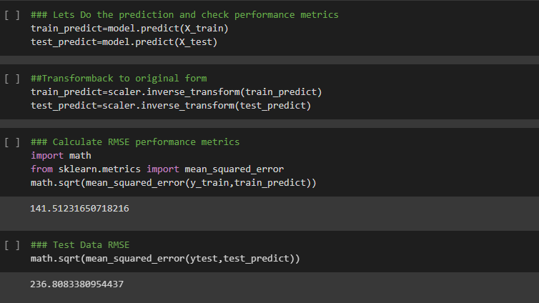
IMPLEMENTATION
VII Semester, Department of CSE, RNSIT
2021 - 2022

Slide 12
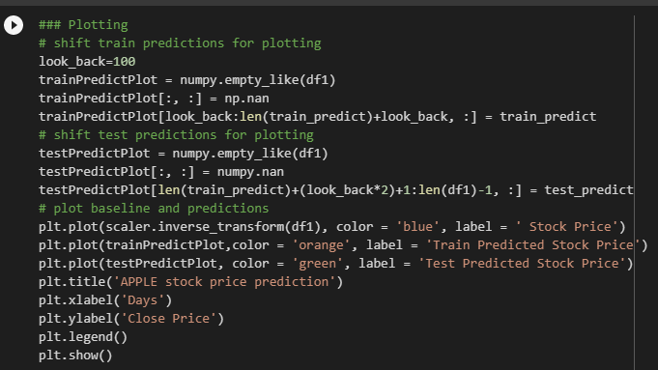
IMPLEMENTATION
VII Semester, Department of CSE, RNSIT
2021 - 2022

Slide 13
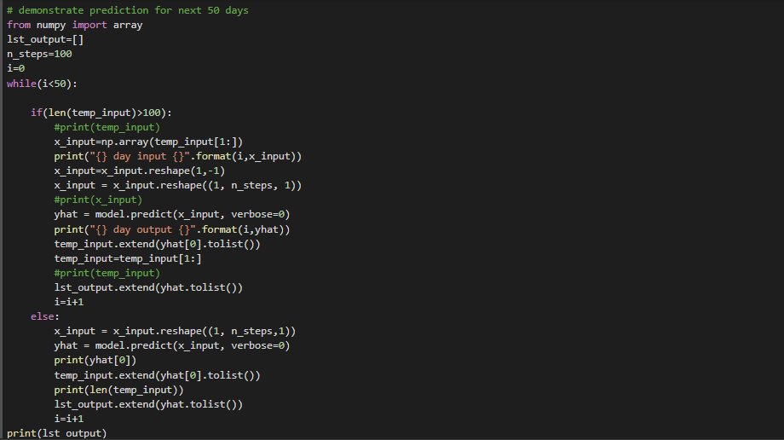
IMPLEMENTATION
VII Semester, Department of CSE, RNSIT
2021 - 2022

Slide 14
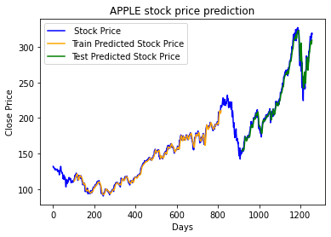
RESULTS
VII Semester, Department of CSE, RNSIT
2021 - 2022

Slide 15
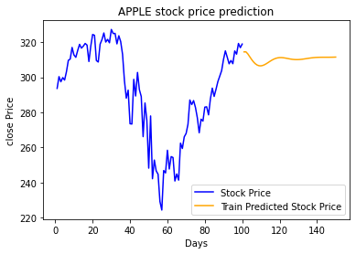
RESULTS
VII Semester, Department of CSE, RNSIT
2021 - 2022

Slide 16
CONCLUSION
We can see the Prediction, analysis and Visualization of Apple stock Price through applying Deep learning algorithms such as LSTM, DENSE and SEQUENTIAL.
Same way we can use any company Stock Dataset directly apply this algorithms it will give us the correct prediction.
This System is Successfully runs on any system even on Cloud platforms.
VII Semester, Department of CSE, RNSIT
2021 - 2022

Slide 17
REFRENCES
https://machinelearningmastery.com/start-here/#getstarted
https://colah.github.io/posts/2015-08-Understanding-LSTMs/
https://www.sas.com/en_us/insights/analytics/machine-learning.html
https://groww.in/us-stocks/googl
https://www.investopedia.com/terms/d/deep-learning.asp
https://www.nasdaq.com/market-activity/stocks/goog
VII Semester, Department of CSE, RNSIT
2021 - 2022

Slide 18
THANK YOU
VII Semester, Department of CSE, RNSIT
2021 - 2022

